Slide 1
Social farming in practice
Name of Lecturer
  Institution of Lecturer
00
00
0000

Slide 2
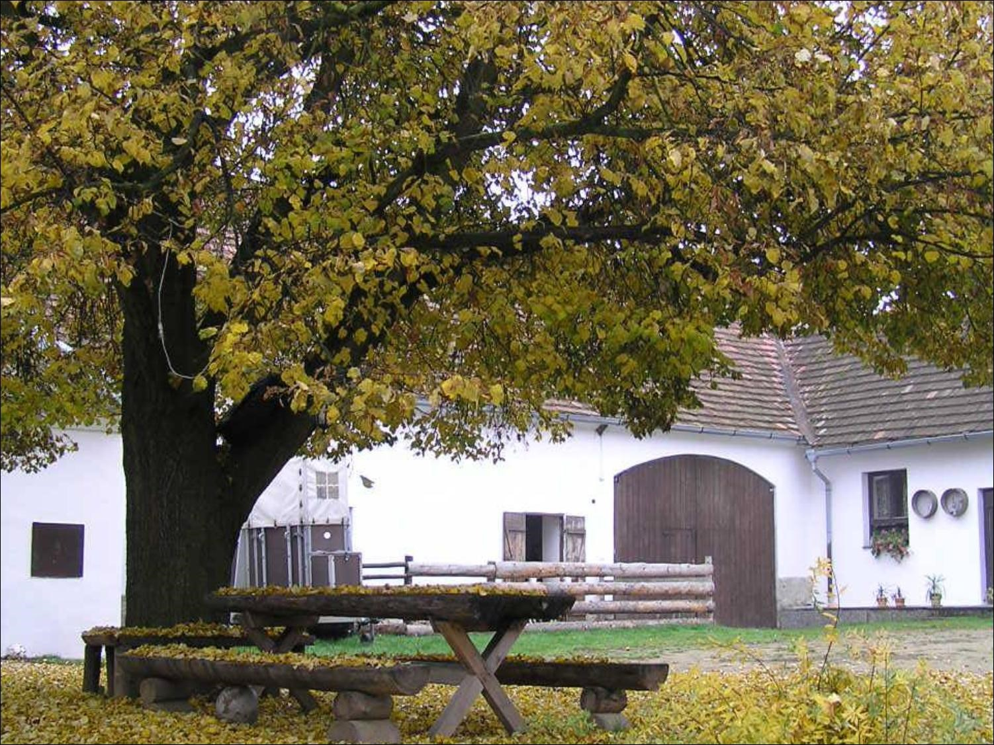
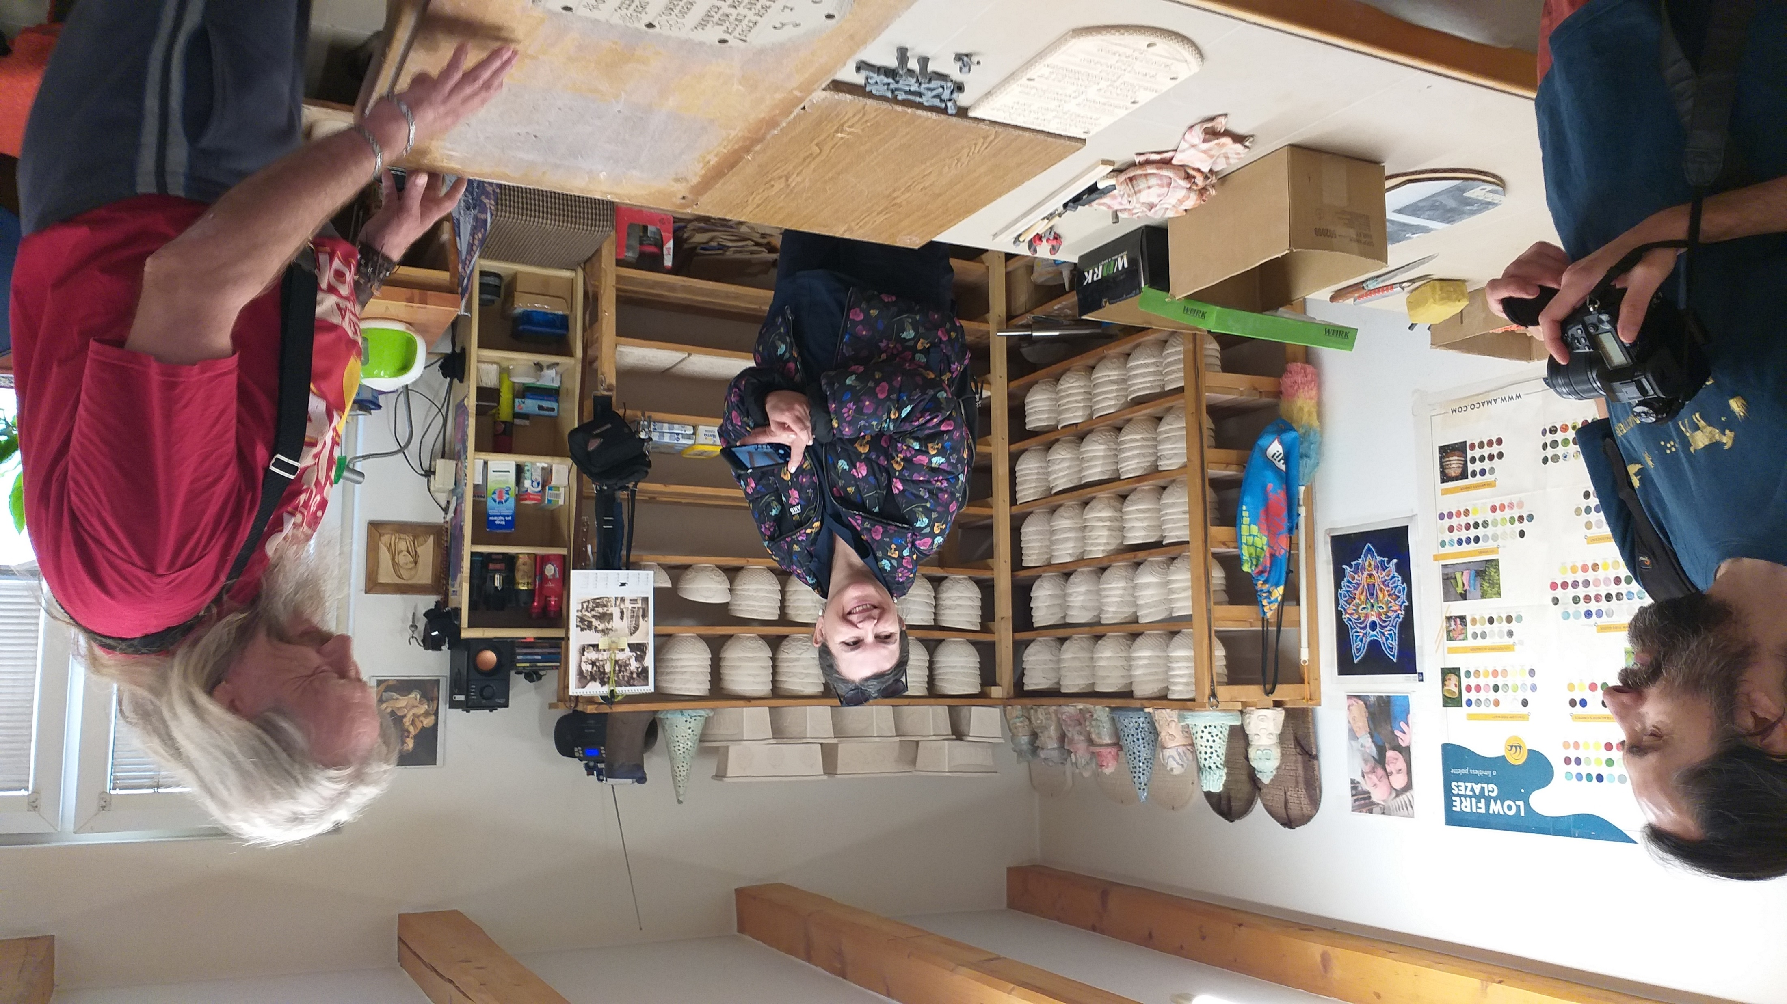
Overview
Farm environment
  Where to start with social farming
  Farm vs. social enterprise
  Modification in relation to social farming
  Social farm sustainability
  Sheltered employment
  Trends in marketing
  Good practice examples
  Functional models
  Farm activities
  Non-production activities

Slide 3
Farm Environment

Slide 4
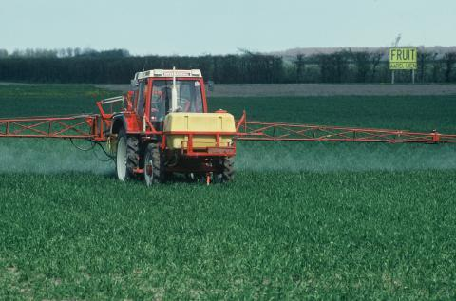
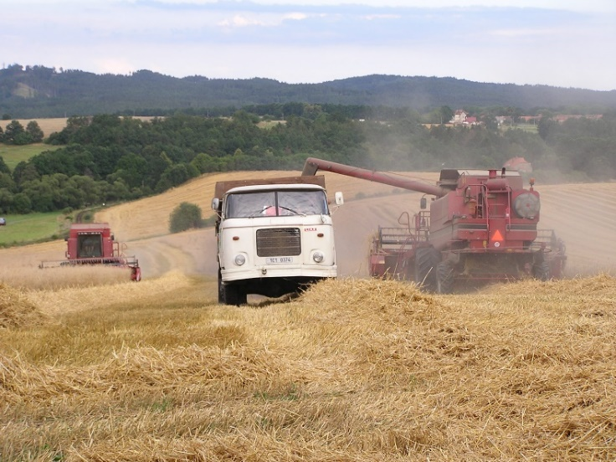
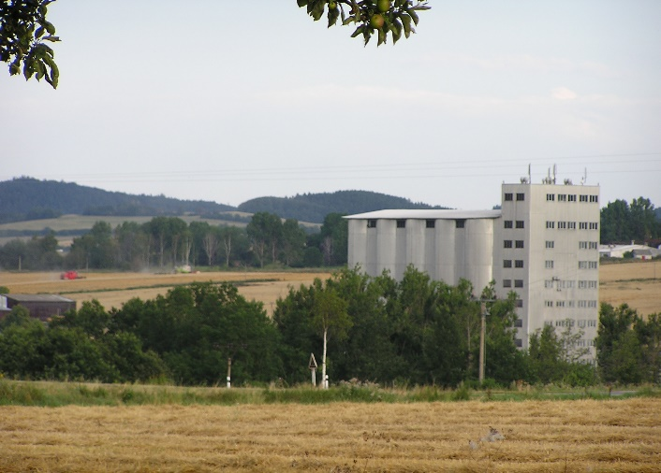
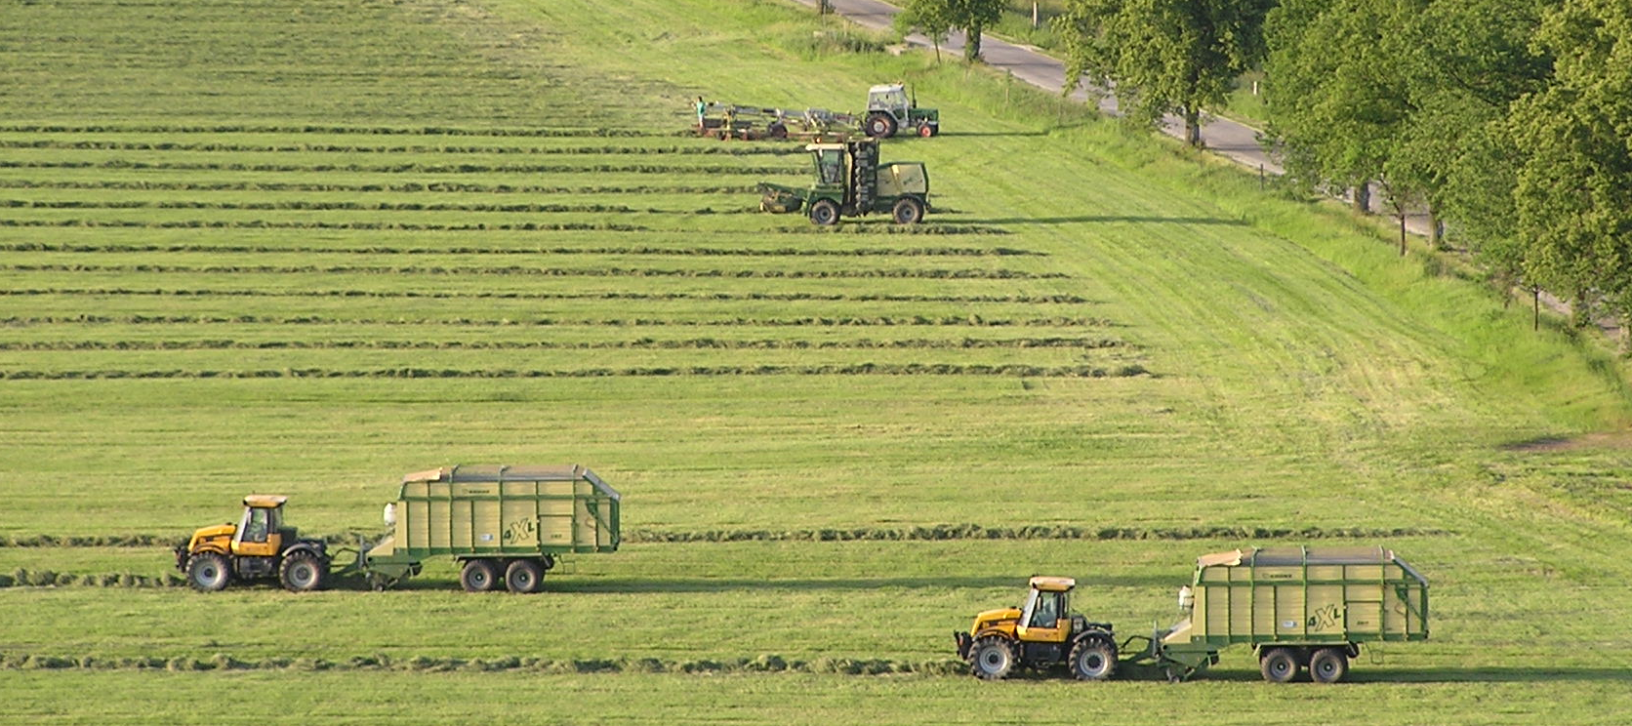
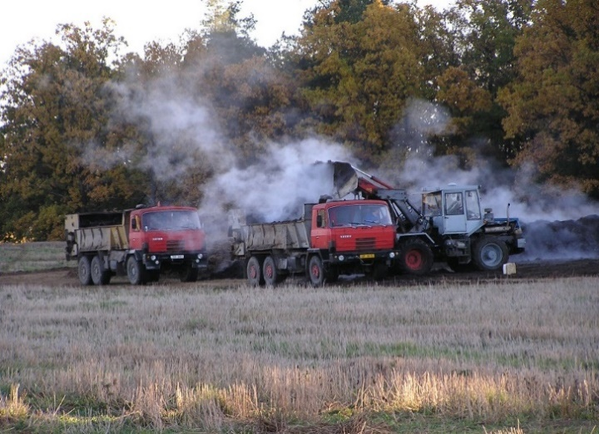
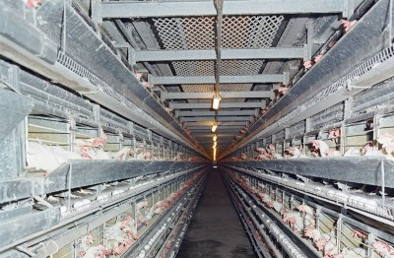
Current trends in agriculture

Slide 5
Dual character of the farms
2,1%
27,9%
70%

Slide 6
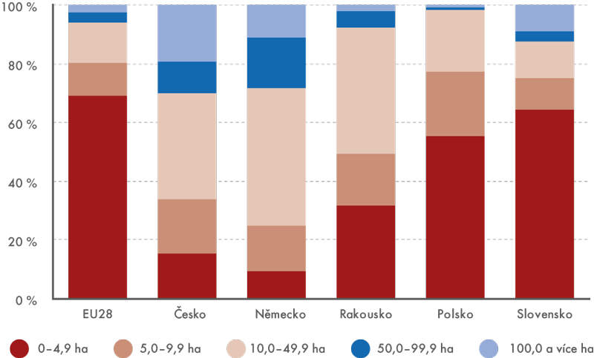





Dual Character of the farms

Slide 7
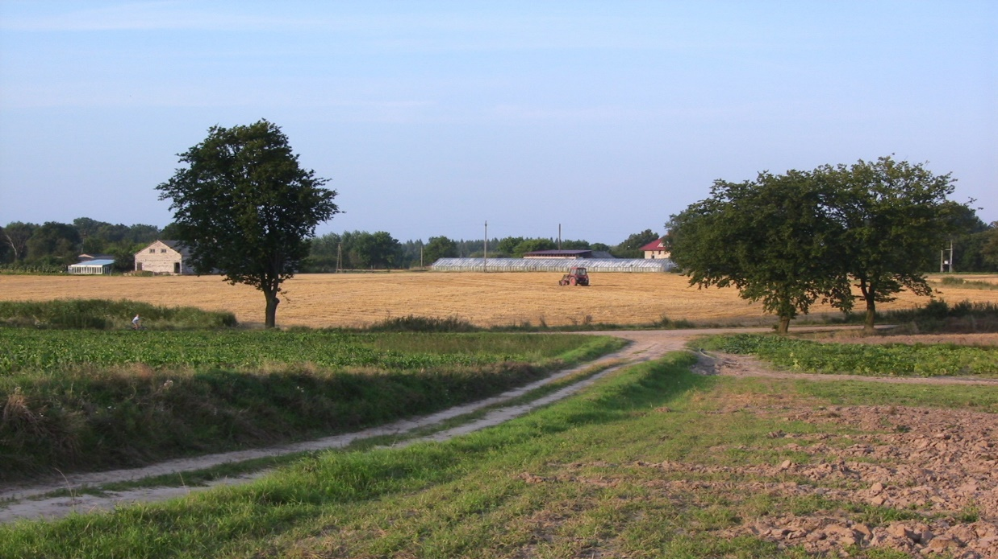
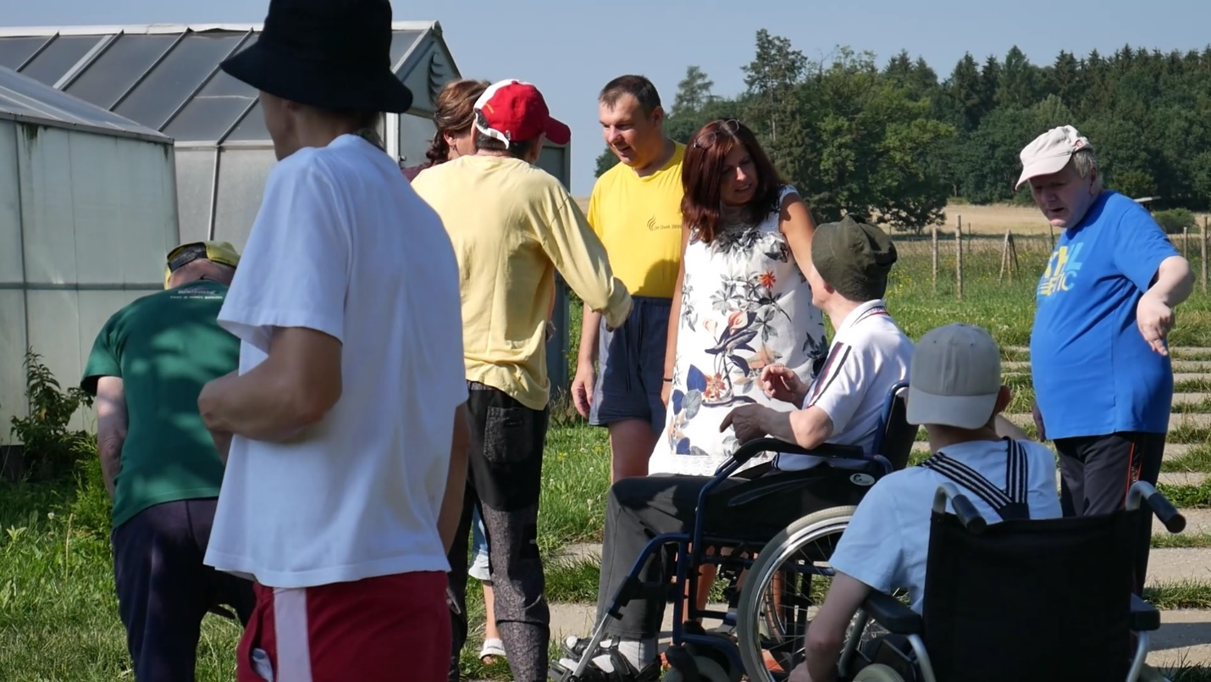
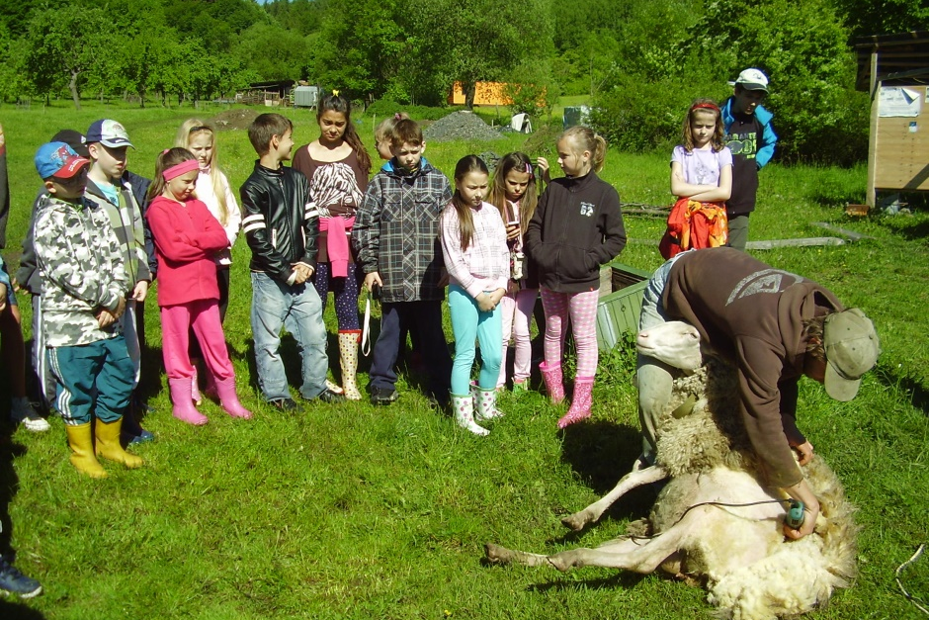
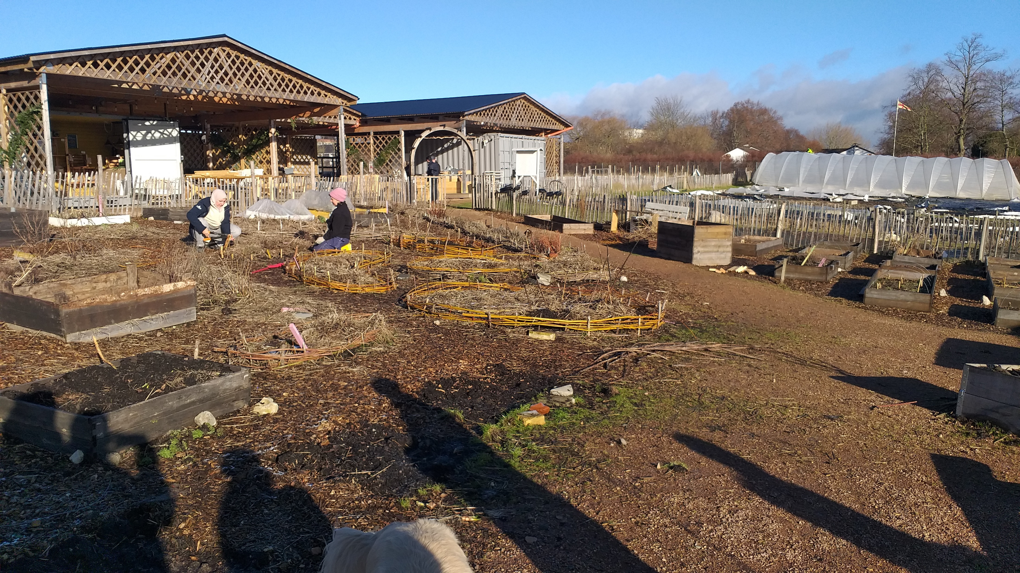
Social Farm vs. social service provider
Social farm
Social service provider

Slide 8
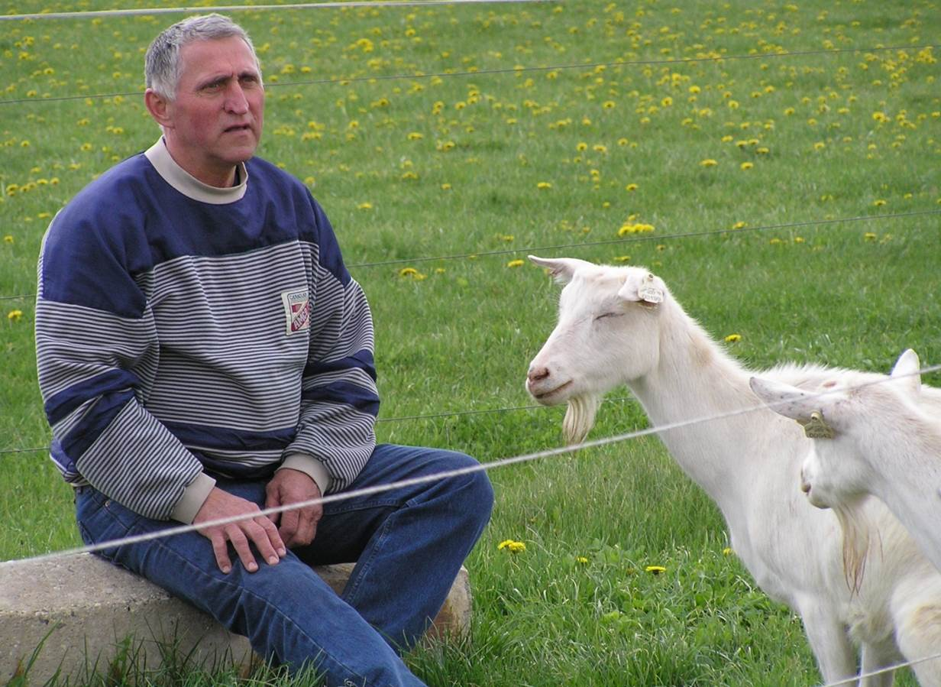
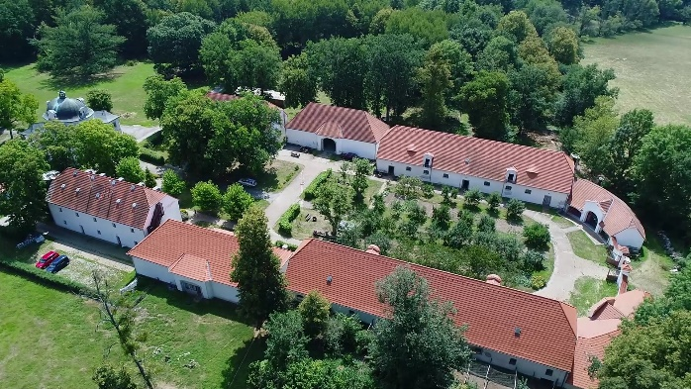
Social Farm vs. social service provider
Farm environment modification
Cooperation with the social worker
Properly prepared working conditions suitable for participants
Beneficial from an economic point of view

Slide 9
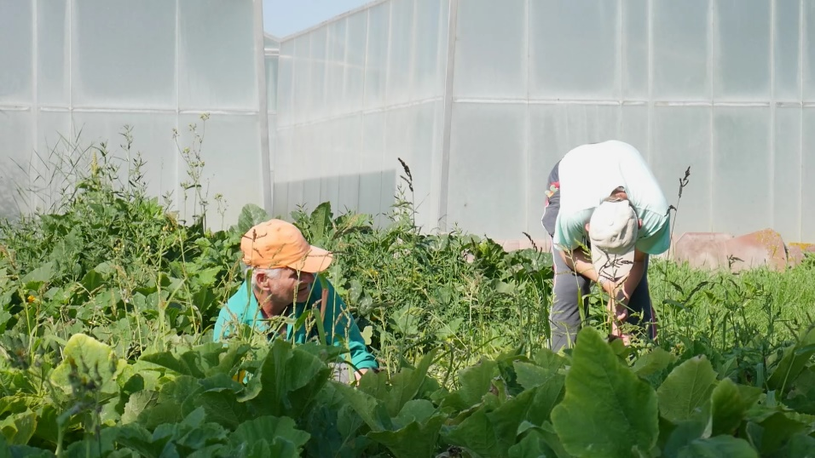
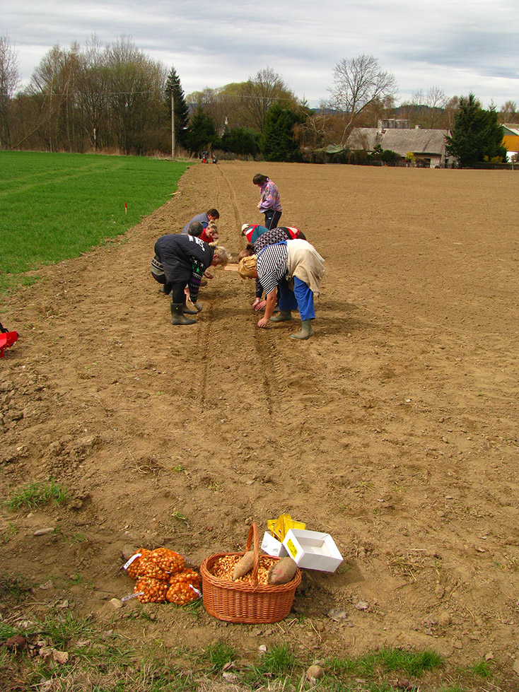
Social Farm vs. social service provider
Farm environment modification
Optimal modification = NO modification
„Participants do practically everything we can imagine on such a farm. On the other hand, we have our limits, or rather typical jobs that we do not direct our employees to do, such as operating more complex machinery, driving a tractor, setting up or adjusting various machines, etc.

Slide 10
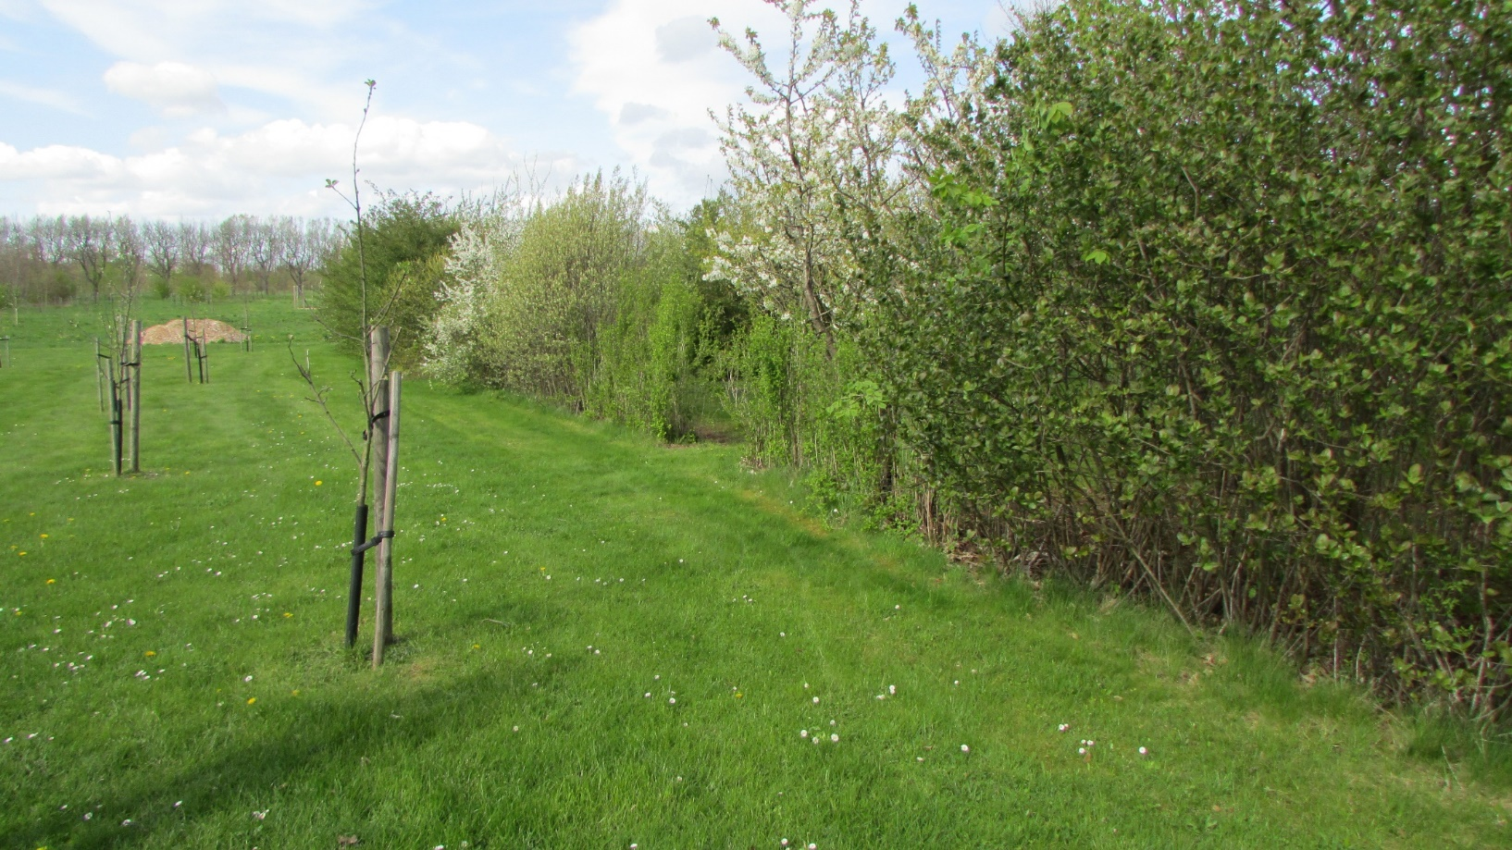
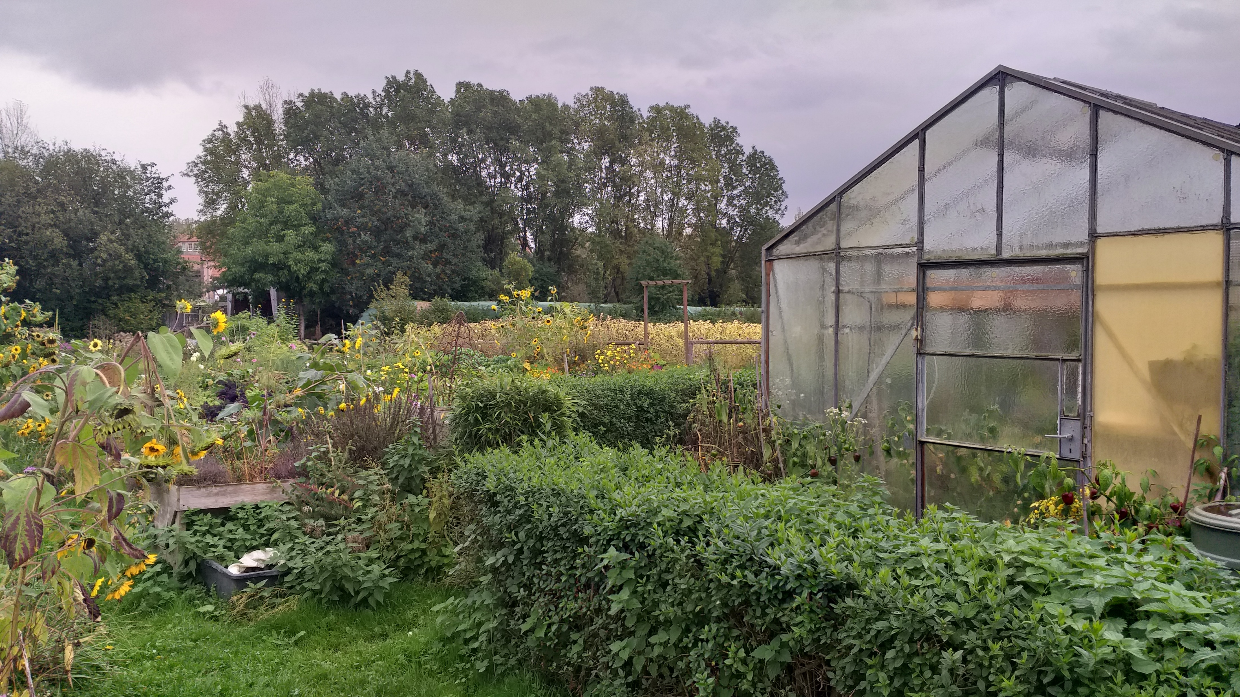
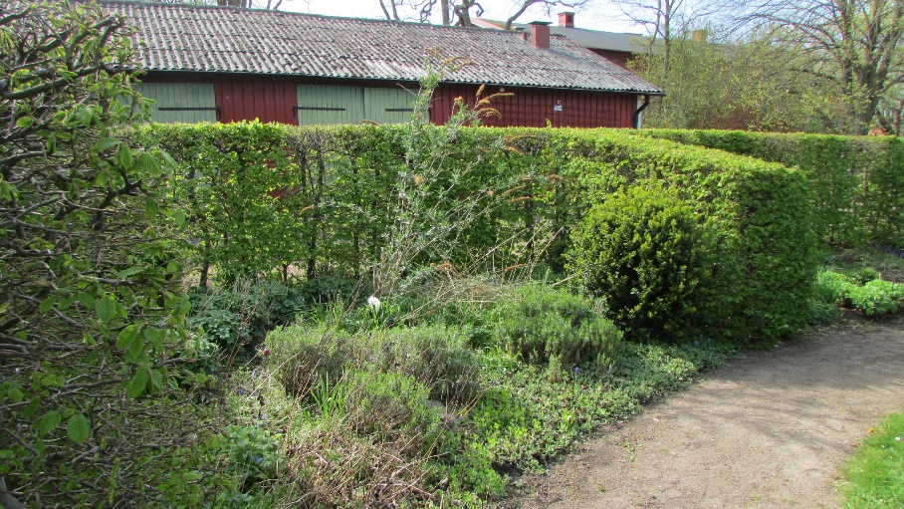
Social Farm vs. social service provider
Social service provider environment modification
Cooperation with the farming specialist
Conditions prepared for therapy and education
Implementation of agriculture into social service environment

Slide 11
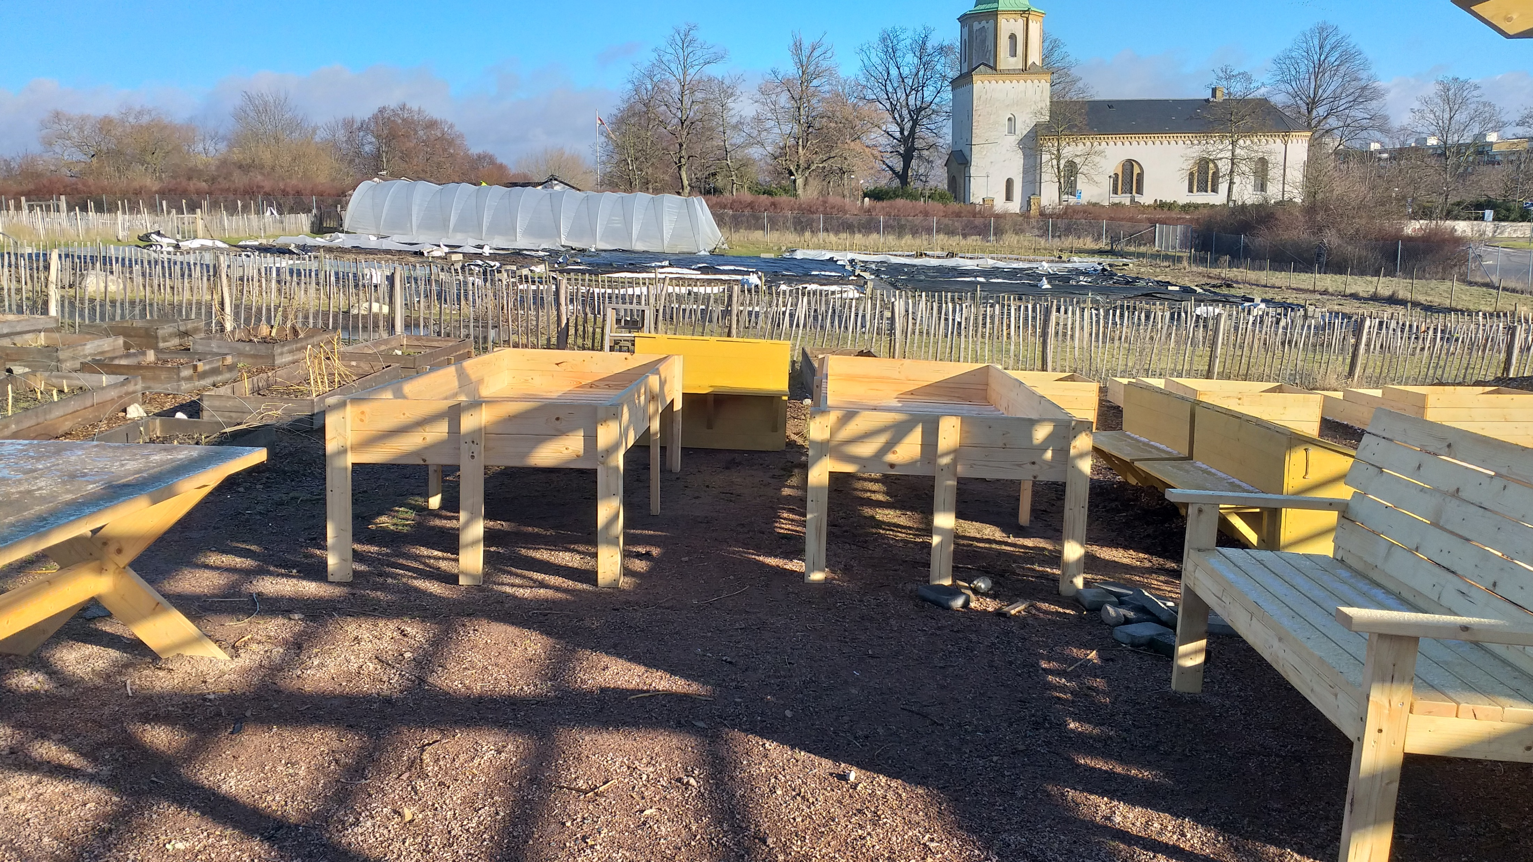
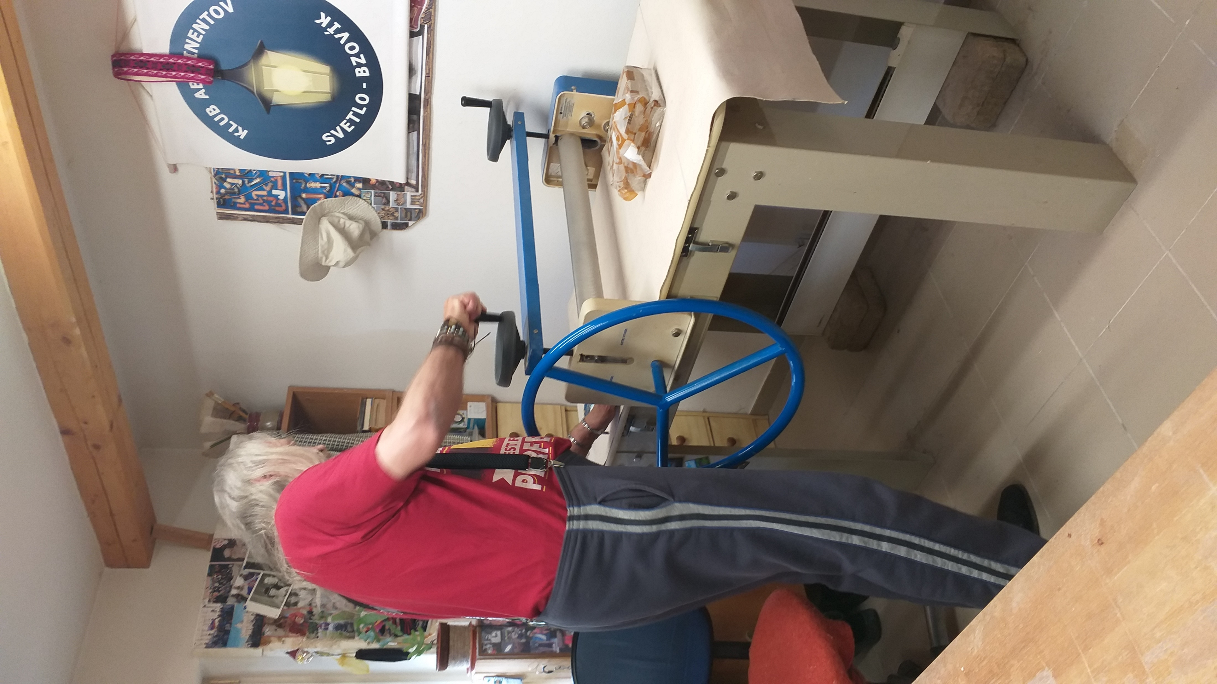
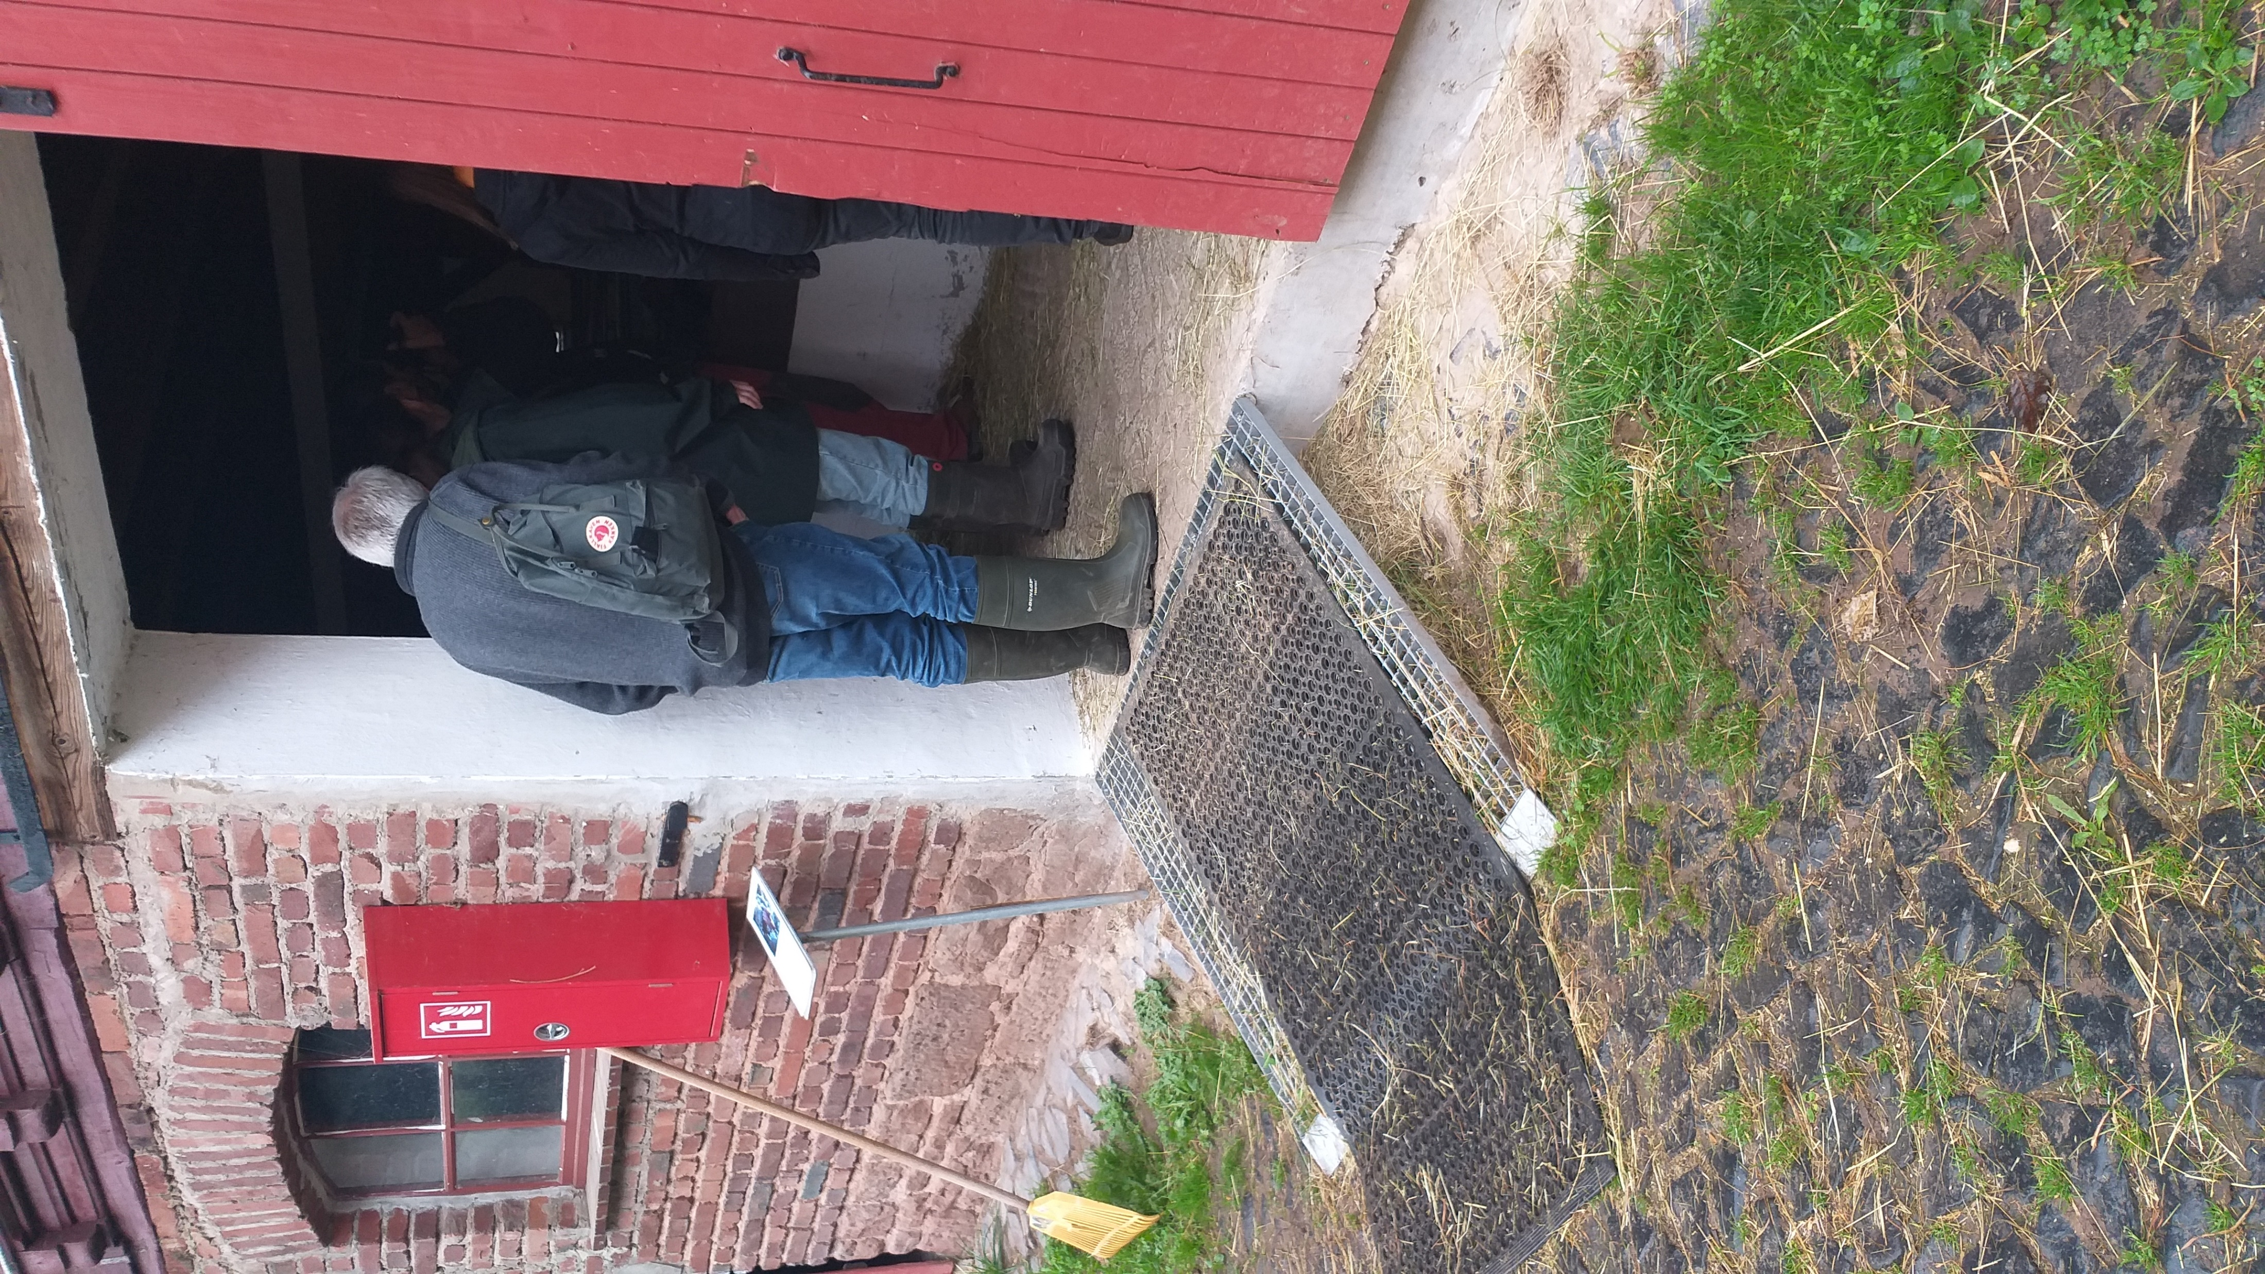
Social Farm vs. social service provider
Social service provider environment modification
Optimal modification = Everything for the participants well being
„We built a ramp for wheelchairs, we built toilets, we expanded the alleys. We have reduced the comfort of the animals, but increased them for people with disabilities.“

Slide 12
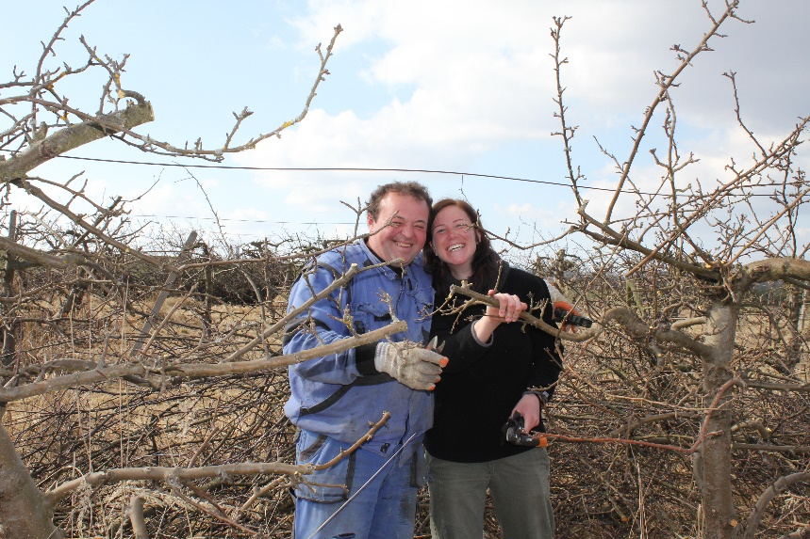
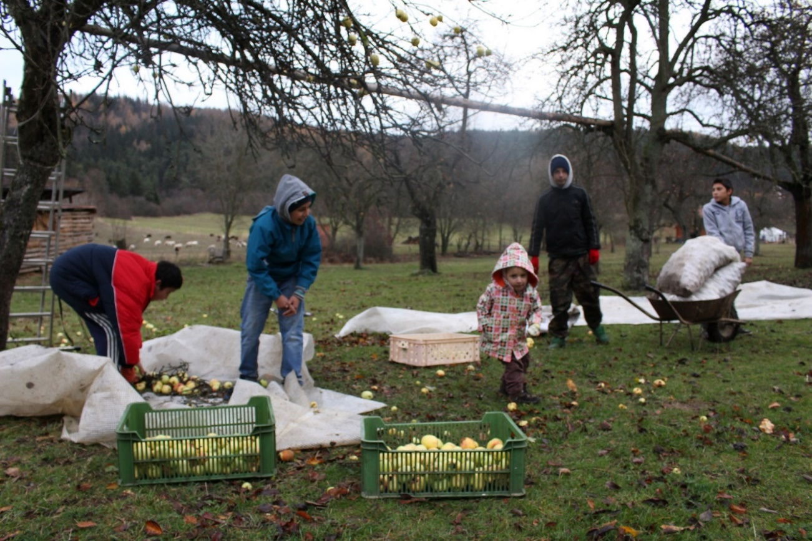
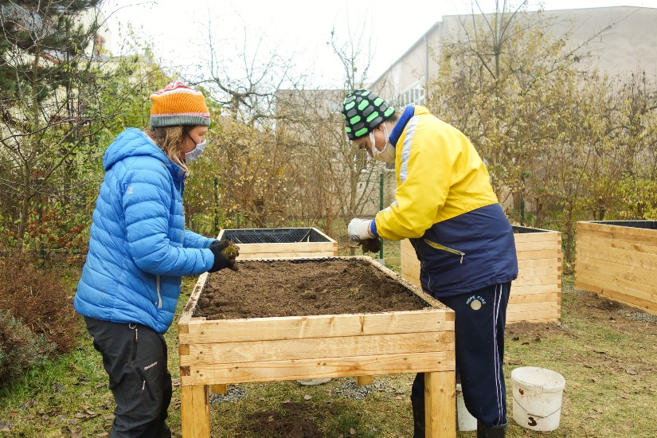
ACTivities suitable for social farming
Plant production
Preparation of seeds and seedlings
Preparation of flowerbeds
Planting, sowing
Treatment during vegetation
Harvest
Post-harvest processing
Works in orchard

Slide 13
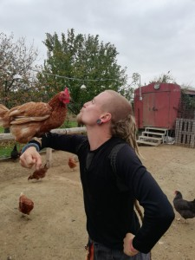
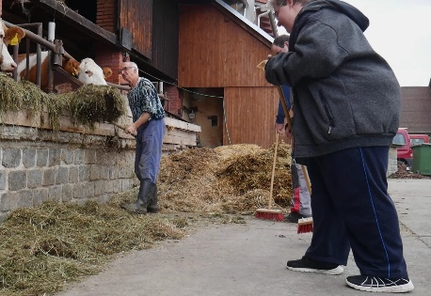
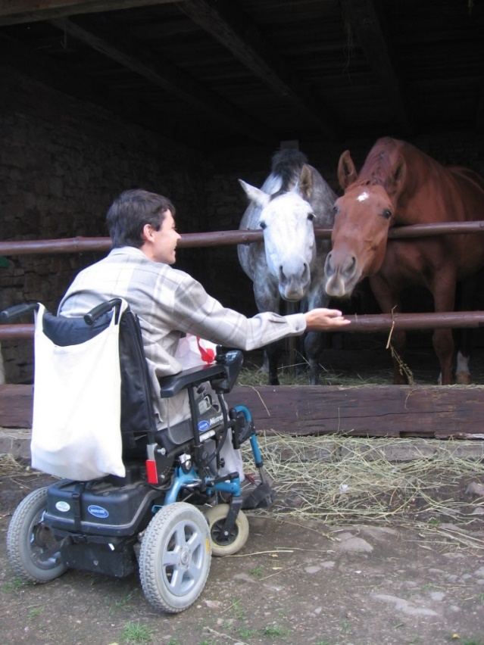
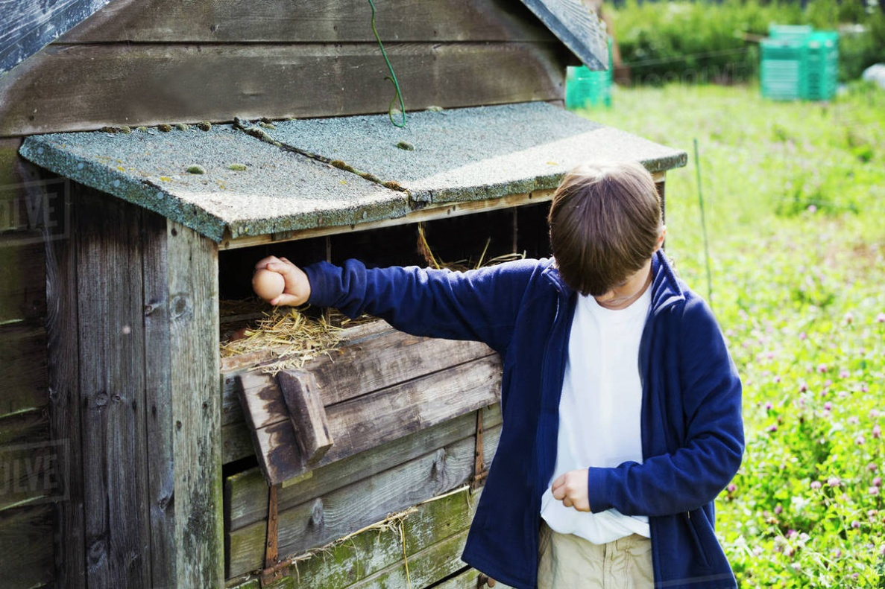
ACTivities suitable for social farming
Animal production
Feed preparation
Feeding
Animal care
Cleaning of stable areas
Work with manure
Care of pasture areas
Eggs collection

Slide 14
Social farm sustainability

Slide 15
Sustainability forms
Different forms of sustainability
Environmental
Environmental
Social
Economics
Economics
Social

Slide 16
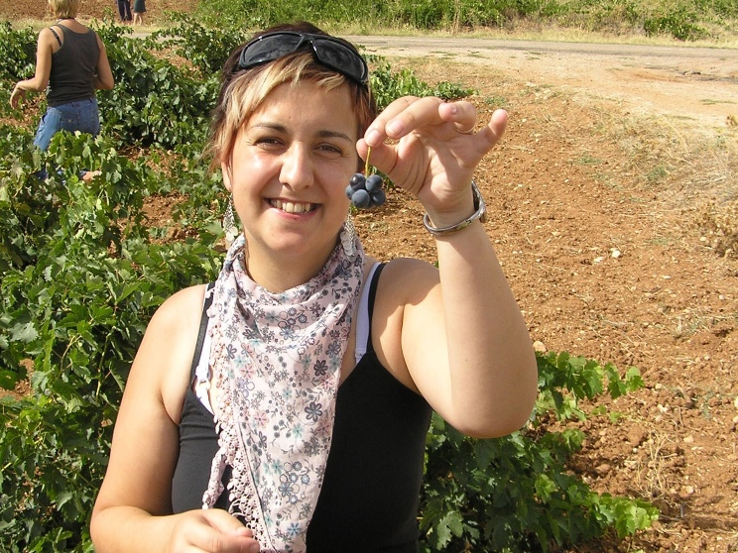
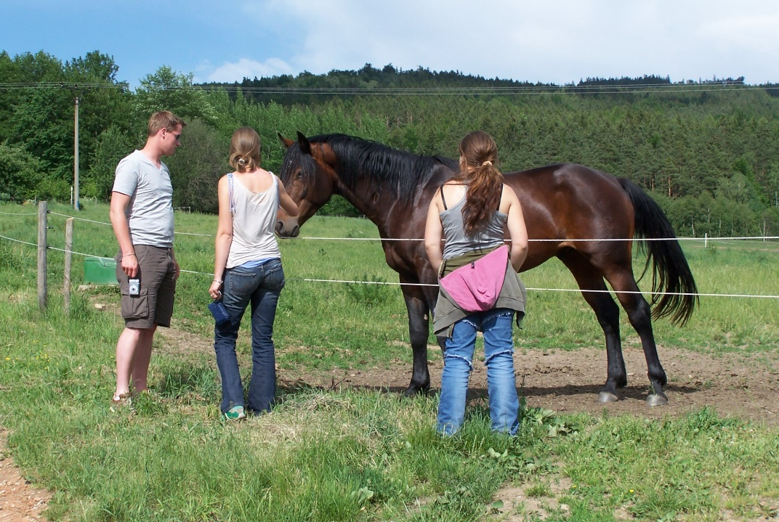
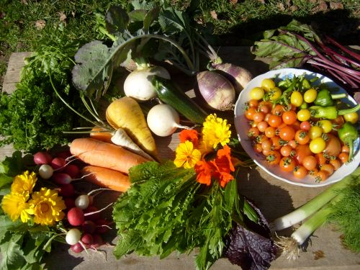
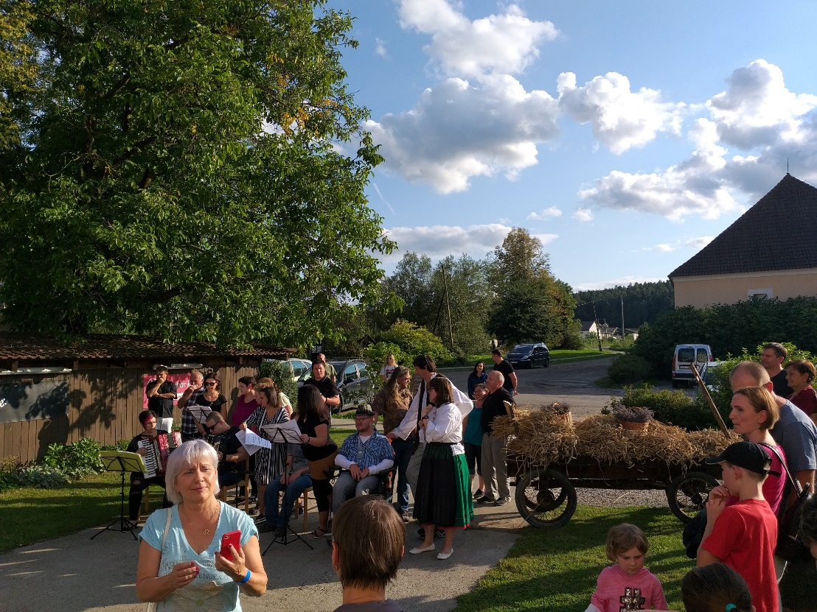
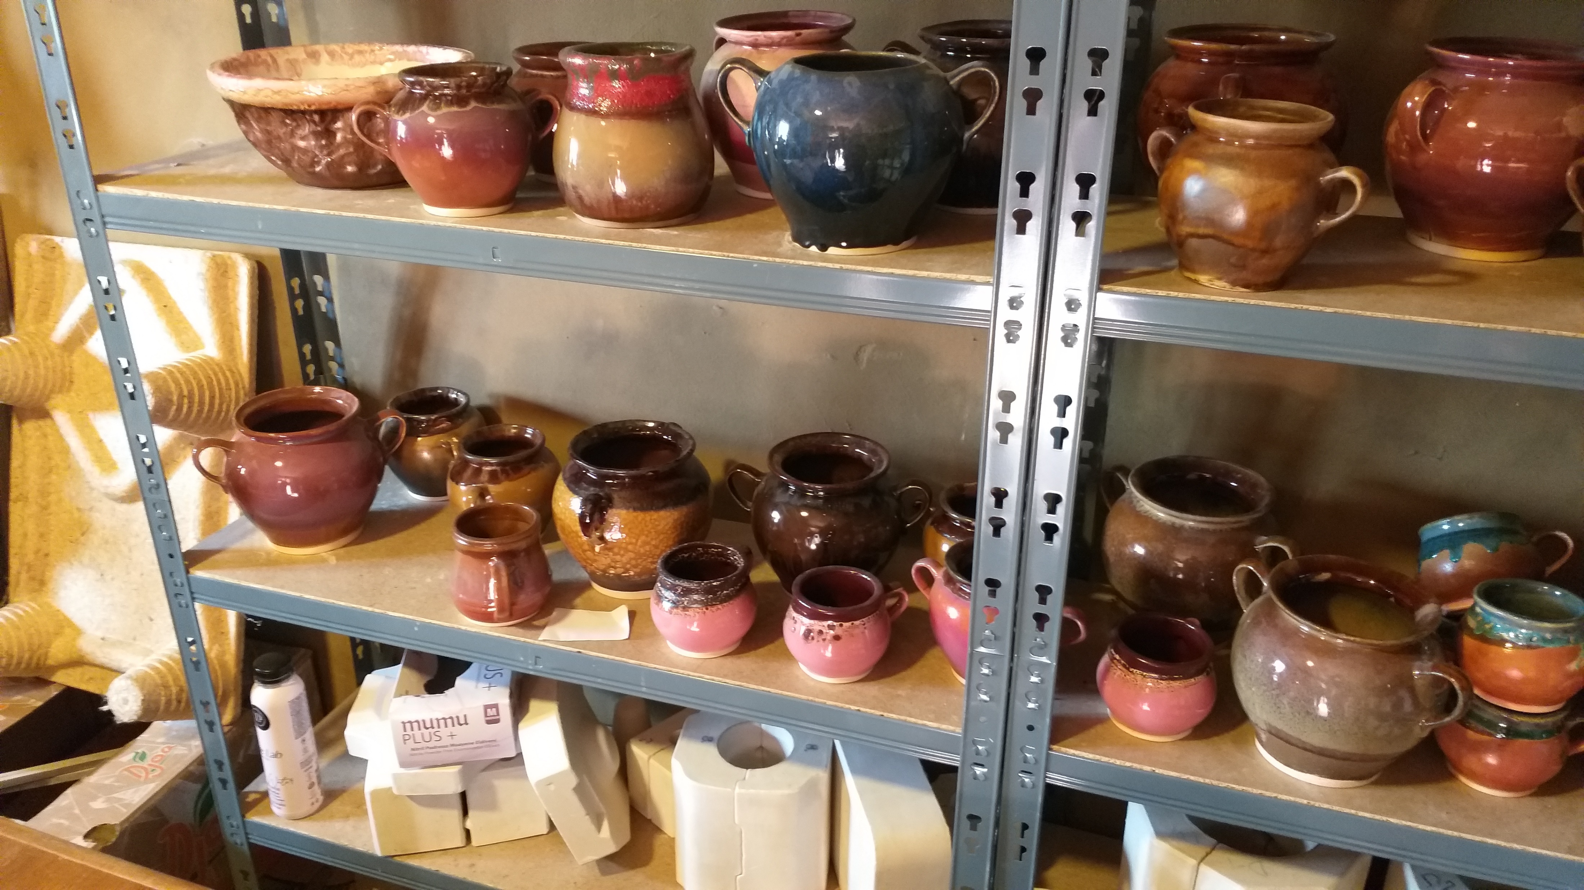
Economic viability
Social farm viability
Can a social farm be economically sustainable?
Different sources of income
Subsidies
Non-productive activities

Slide 17
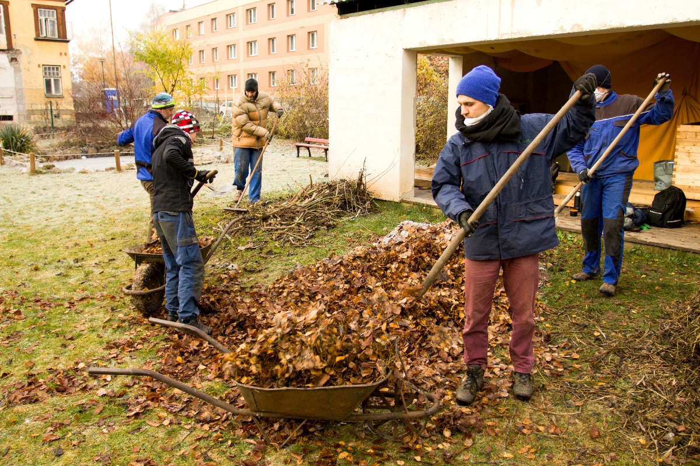
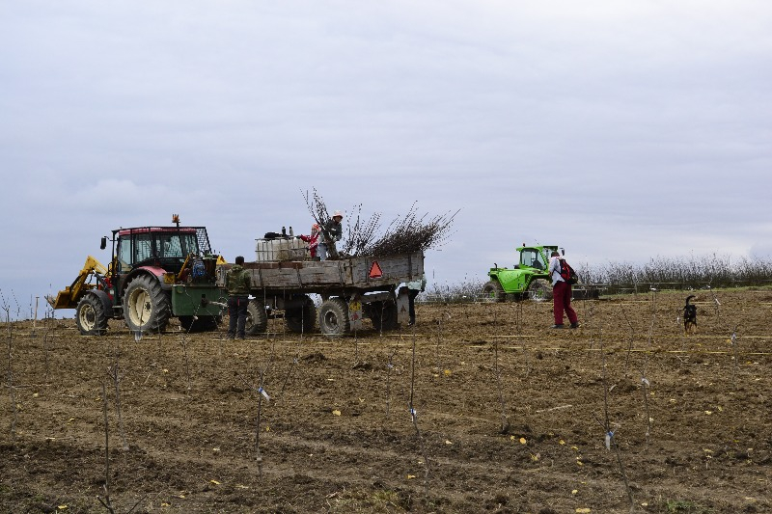
Sheltered employment
Tool for sustainability?
To assist individuals who for whatever reason are viewed as
not capable of working in a competitive employment setting in their local community.
Salaries partially covered by government
Limited working hours/day

Slide 18



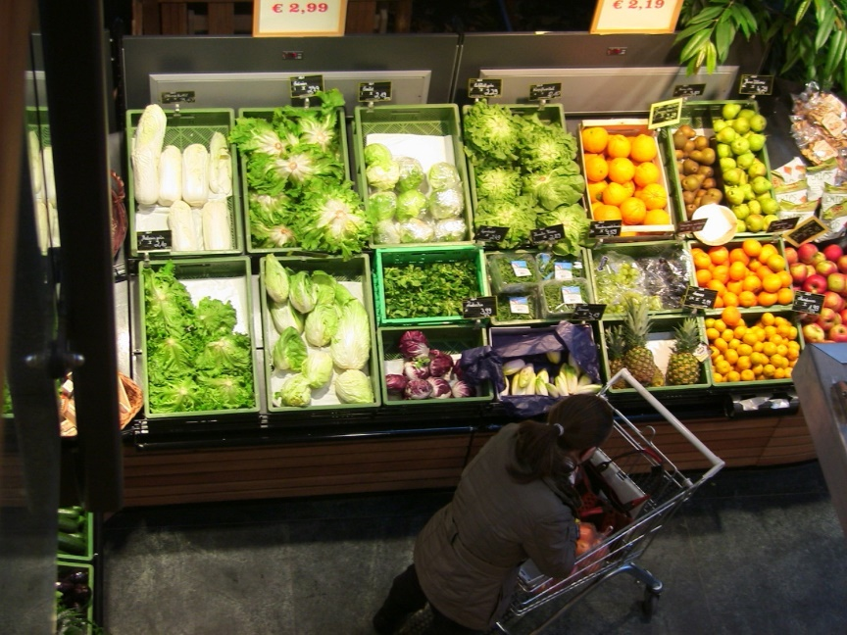
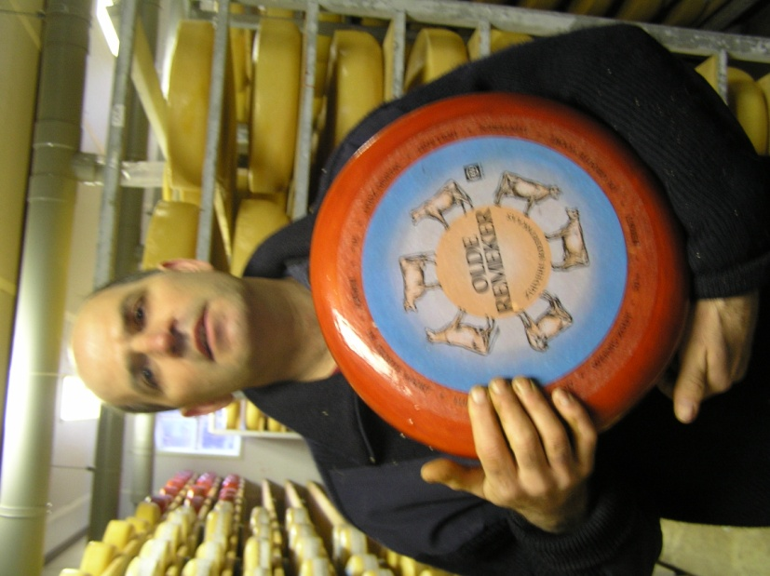
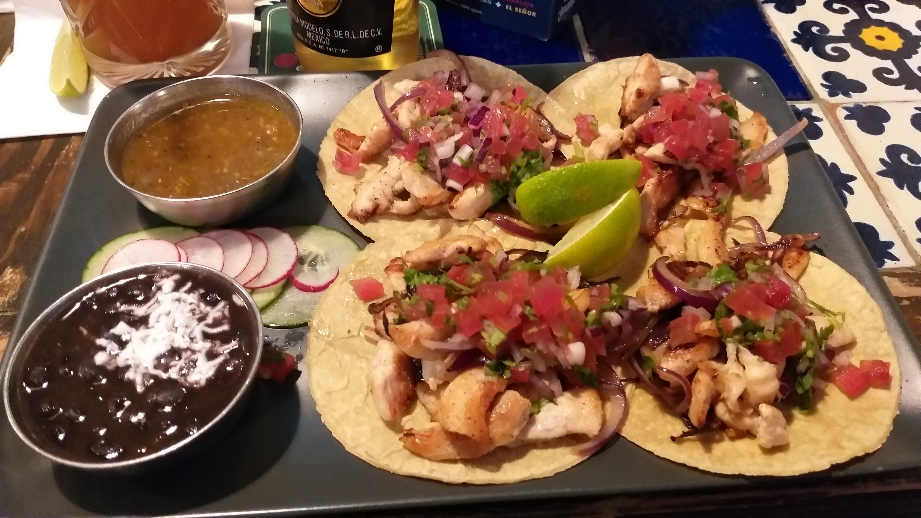
Trends in marketing
To whom do we sell products?
B2B/B2C?
What is suitable product?
Where is our additional value?
Which trends will sell?
CSR?

Slide 19
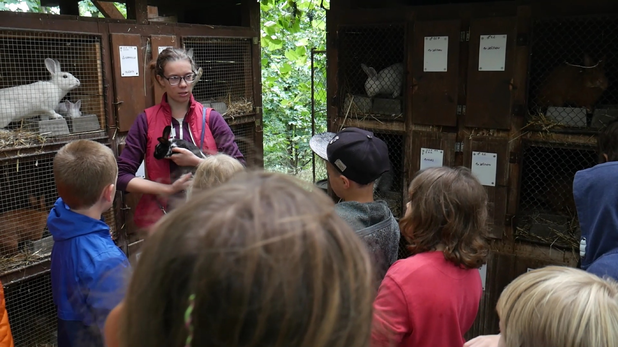
Farm or „farm“
What can we do on the farm, except farming?
Leisure
Services
Relax
Experiences
Education

Slide 20
Good Practice examples

Slide 21

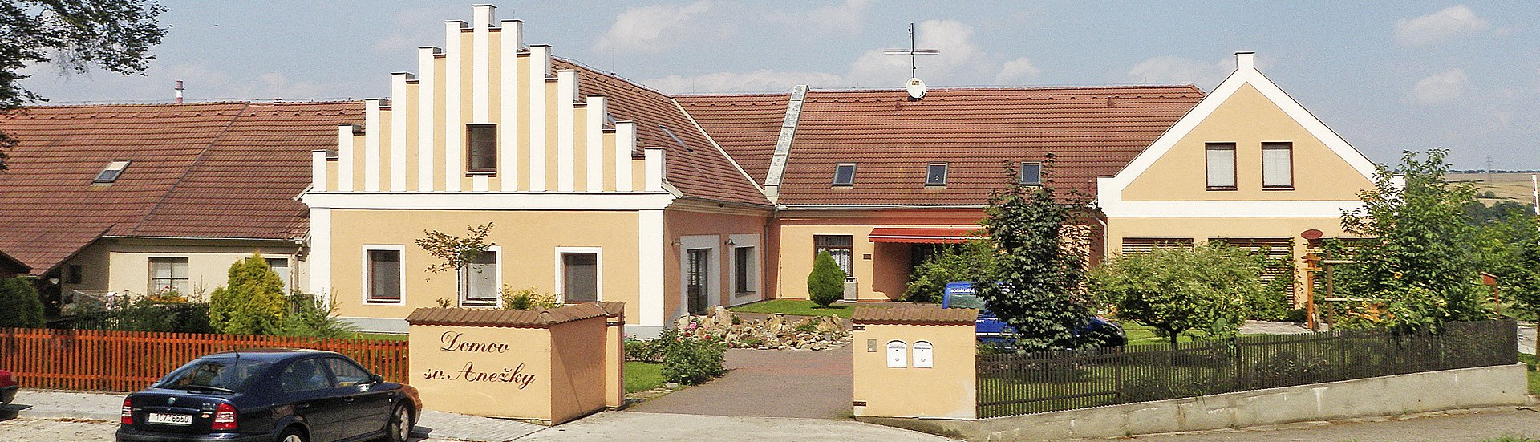
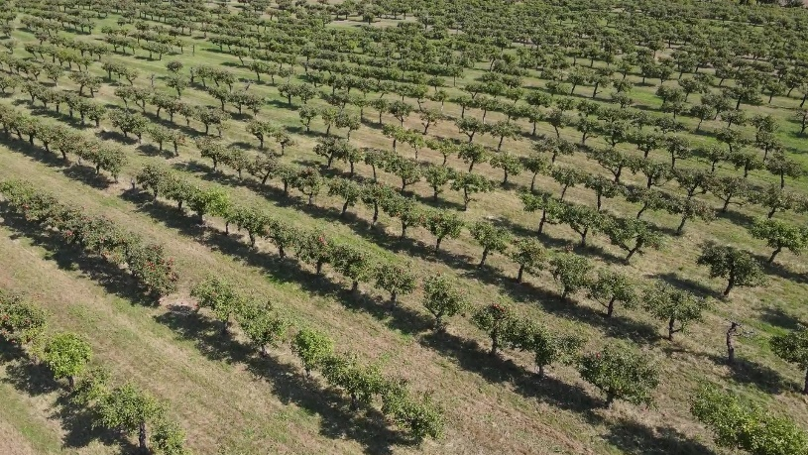
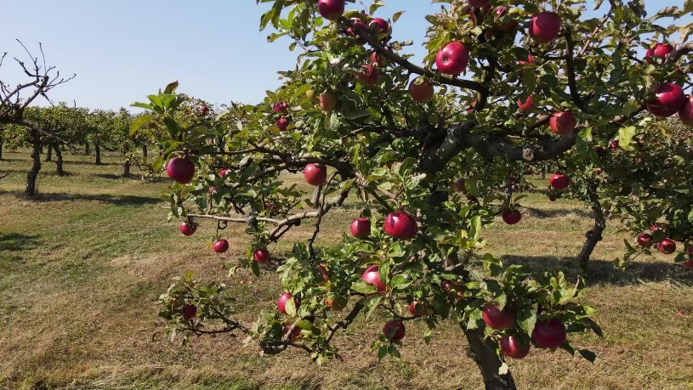
POMOC association
Established organisations
  Domov sv. Anežky, o.p.s.
  Dílny sv. Jiljí, o.p.s.
  Domovy KLAS, o.p.s.
Connected organisations
  Sady sv. Prokopa
  Dvůr Čihovice
  Statek Netěchovice

Slide 22
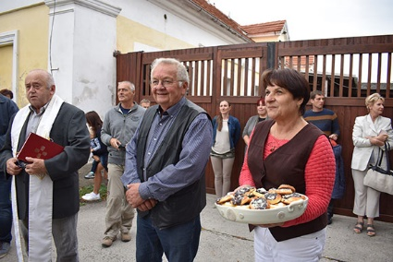
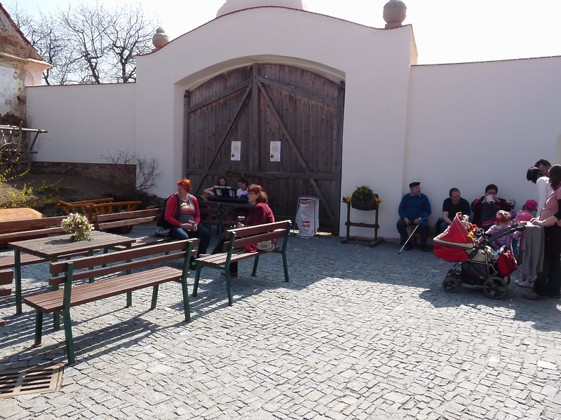
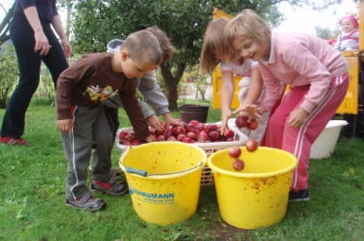
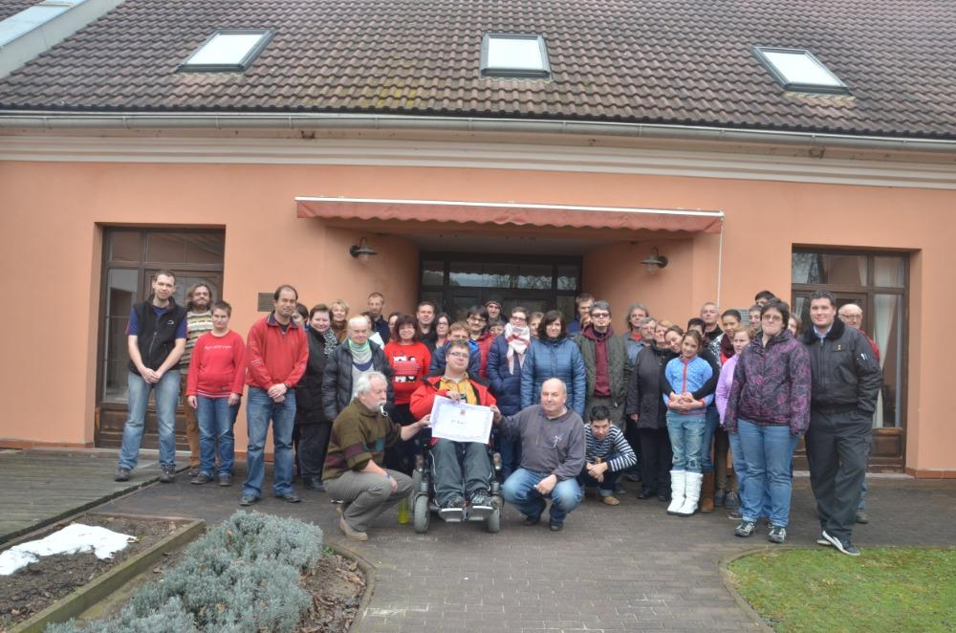
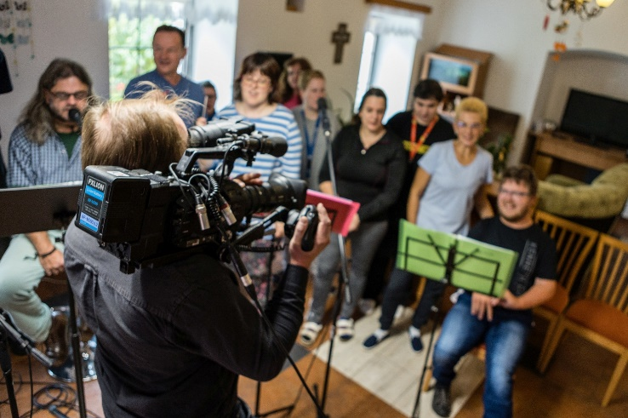
POMOC association
Social services
  Sheltered housing
  Rehabilitation
  Work with elderly, families, children, youth
  Freetime clubs
  Maternity and low-threshold centers

Slide 23
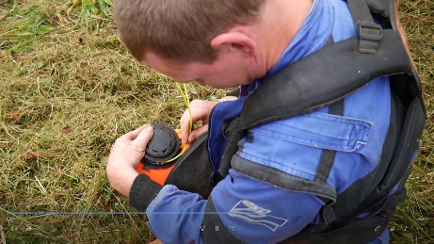






POMOC association
Sheltered workshops
  Gardens, orchards
  Wood processing
  Wool and textiles processing
  Support work and maintenance
  Technical services and transport

Slide 24





POMOC association
Sheltered employment
  Three grade system
  Preparation for entering the open labor market

Slide 25





St. Prokop Orchards
Growing and processing
  Apples
  Plums
  Strawberies
  Potatoes
  Organic, raw, lower CO₂ footprint…

Slide 26





POMOC association
Non-production activities
  Harvest festival
  Agritourism
  Weddings
  Cultural sessions
  Open gates days
  Agricultural museum
  Chapel of St. Agnes

Slide 27
thank you for your attention
Name of Lecturer
  Institution of Lecturer
name@xyz.com

Slide 28

Farming with Refugees and forced displaced people - Agriculture as a path of inclusion
© 2023 by SoFarTEAM is licensed under CC BY-NC 4.0.
To view a copy of this license, visit http://creativecommons.org/licenses/by-nc/4.0/
The slides were created by Jan Moudrý
Contact:
University of South Bohemia in České Budějovice
Studentská 13
370 05 České Budějovice, Czech Republic
jmoudry@fzt.jcu.cz

